Slide 1





Holistic Specifications for Robust Code
Sophia Drossopoulou Imperial College London and MSR Cambridge in collaboration with James Noble and Julian Maccay (VU Wellington), Toby Murray (Uni Melbourne) , Mark Miller (Agorics), and Susan Eisenbach, Shupeng Loh and Emil Klasan (Imperial)

Slide 2
Today
Traditional Specifications do not adequately address Robustness
Holistic Specifications — Summary and by Example
Holistic Specification Semantics

Slide 3
Traditional Specs
Robustness considerations
closed world
open world
sufficient conditions for some action/effect
necessary conditions for some action/effect
emergent behaviour
talk of individual function

Slide 4

An Example

Slide 5


class SafeTwo{
private fld secret; private fld treasure; mthd take(s){
…. }
constr SafeTwo(s,t){ … }
mthd set(s) { this.secret=s;} }
class SafeThree{
private fld secret; private fld treasure; mthd take(s){
…. }
constr SafeThree(s,t){ … }
mthd set(s,sold) { if sold==secret then { this.secret=s;}} }
class SafeOne{
private fld secret; private fld treasure; mthd take(s){
if (s==secret) { t=treasure; treasure = null; return t; } }
constr SafeOne(s,t){ secret=s; treasure = t; }
}
traditional
SpecA:
{ true } sf.take(s)
{ s=sf.secret -> sf.treasure_{post} = null ∧ s≠sf.secret -> sf.treasure_{post} = sf.treasure_{pre} }
SafeOne ⊨ SpecA
SafeTwo ⊨ SpecA
traditional
SafeTree ⊨ SpecA
SpecB: ∀sf:Safe.[ sf.secret_{pre} = sf.secret_{post} ]
SafeOne ⊨ SpecB
SafeTwo ⊭ SpecB
SafeThree ⊭ SpecB
traditional specs do not express robustness!

Slide 6
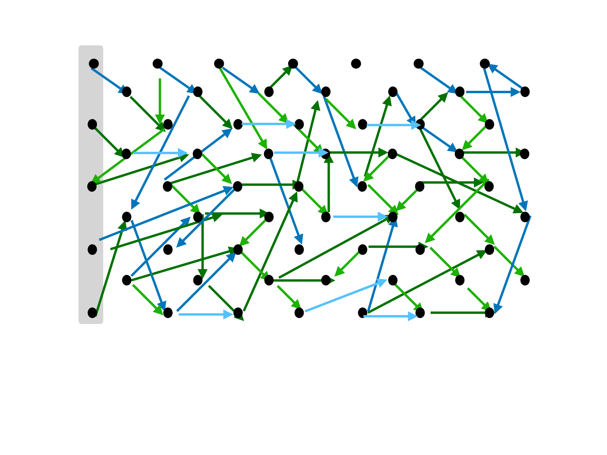

Slide 7
class SafeOne{
private fld secret; private fld treasure; mthd take(s){
if (s==secret) { t=treasure; treasure = null; return t; } }
constr SafeOne(s,t){ secret=s; treasure = t; }
}
class SafeTwo{
private fld secret; private fld treasure; mthd take(s){
…. }
constr SafeTwo(s,t){ … }
mthd set(s) { this.secret=s;} }
class SafeThree{
private fld secret; private fld treasure; mthd take(s){
…. }
constr SafeThree(s,t){ … }
mthd set(s,sold) { if sold==secret then { this.secret=s;}} }
traditional
SpecA:
{ true } sf.take(s)
{ s=sf.secret -> sf.treasure_{post} = null ∧ s≠sf.secret -> sf.treasure_{post} = sf.treasure_{pre} }
SafeOne ⊨ SpecA
SafeTwo ⊨ SpecA
traditional
SafeThree ⊨ SpecA
SpecB: ∀sf:Safe.[ sf.secret_{pre} = sf.secret_{post} ]
SafeOne ⊨ SpecB
holistic
SafeTwo ⊭ SpecB
SafeThree ⊭ SpecB
SpecC: ∀sf:Safe.[ Will(Changes(sf.treasure)) ⟶ ∃ o.[ External<o> ∧ Access(o,sf.secret) ]
SafeOne ⊨ SpecA
SafeTwo ⊭ SpecC
SafeThree ⊨ SpecC

Slide 8
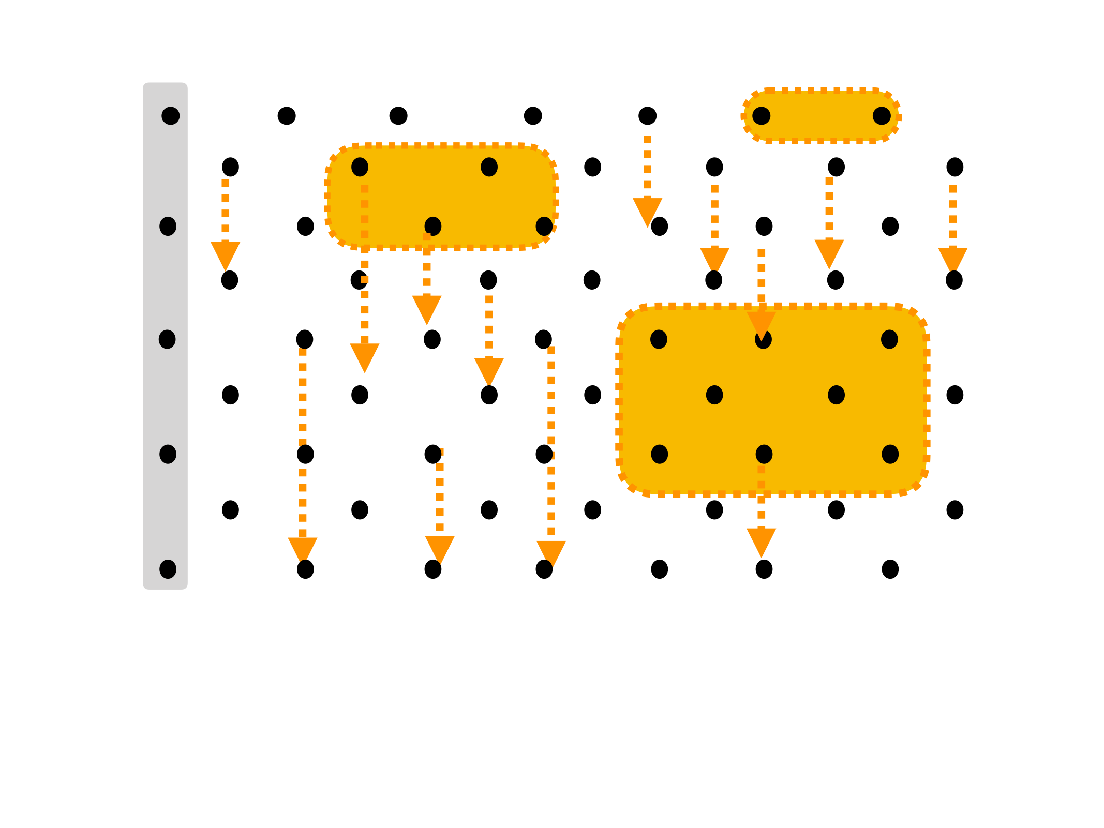
Notes:
states not to be reached in yellow boxes
transitions to be taken through yellow arrows.

Slide 9
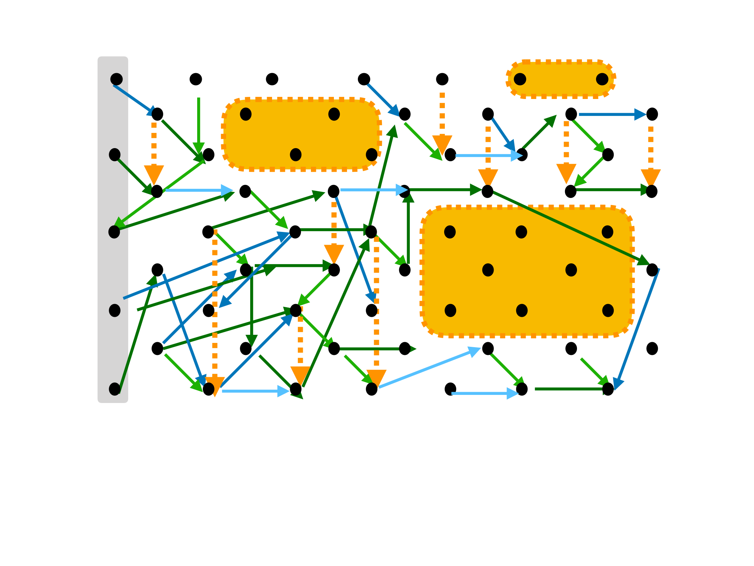
Notes:
Holistic!!

Slide 10
Today
Traditional Specifications do not adequately address Robustness
Holistic Specifications — Summary Examples
Holistic Specification Semantics

Slide 11
Holistic Assertions — summary
e ::= this | x | e.fld | …
A ::= e>e | e=e | …
| A → A | A ∧ A | ∃x. A | …
| Access(e,e’)
permission
| Changes(e)
authority
| Will(A) | Was(A)
time
space
| A in S | External(e)
| x.Calls(y,m,z1,..zn)
control
| x obeys A
trust

Slide 12
Holistic Assertions — examples
ERC20
DAO
DOM attenuation
Bank & Account
Escrow

Slide 13
Example1: ERC20
a popular standard for initial coin offerings; allows clients to buy and transfer tokens, and to designate other clients to transfer on their behalf.
In particular, a client may call - transfer: transfer some of her tokens to another clients,
approve: authorise another client to transfer some of her tokens on her behalf.
transferFrom: cause another client’s tokens to be transferred
Moreover, ERC20 keeps for each client - balance the number of tokens she owns

Slide 14
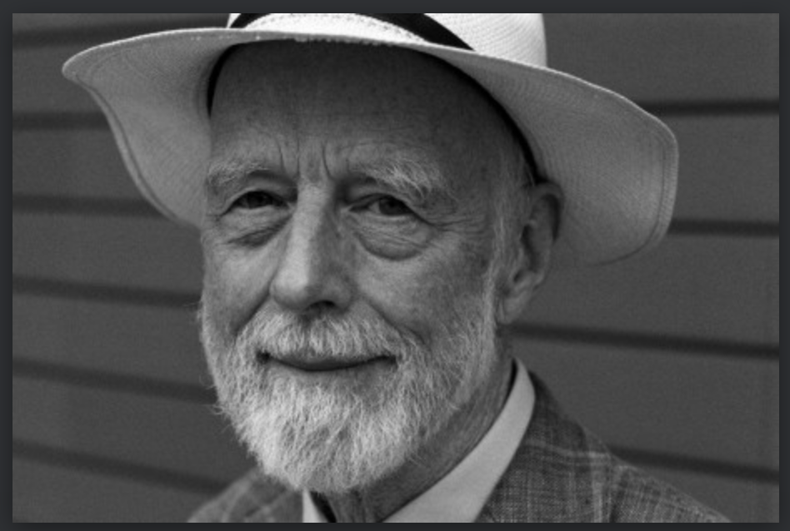
classical specs - Hoare triples
A
{ x calls y.f(args) }
A’
If A hods, and x calls y.f(args), then, A’ holds after the call
precondition
postcondition

Slide 15
ERC20 classical spec - transfer
For any ERC20 contract e, and different clients c1, c2.
c1’s balance is larger than m.
{ c1 calls e.transfer(c2,m) }
c1’s balance decreases by m, and c2’s balance increases by m.
e:ERC20 ∧ this = c1≠c2 ∧ e.balance(c1) >m { e.transfer(c2,m) }
e.balance(c1) = e.balance(c1)pre -m ∧ e.balance(c2) = e.balance(c2)pre +m
sufficient condition
effect
precondition
postcondition

Slide 16
ERC20 classical spec - transfer - 2
What if c1’s balance not large enough?
e:ERC20 ∧ this = c ∧ e.balance(c1) < m { e.transfer(c2,m) }
∀ c. e,balance(c) = e,balance(c)pre

Slide 17
ERC20 classical spec - what about the other functions?

Slide 18

ERC20 classical spec
a “super-cleint,” authorised on all?
e:ERC20 ∧ this = c1≠c2 ∧ e.balance(c1) >m { e.transfer(c2,m) }
e.balance(c1) = e.balance(c1)pre -m ∧ e.balance(c2) = e.balance(c2)pre +m
e:ERC20 ∧ this = c1 ∧ e,balance(c1) < m { e.transfer(c2,m) }
∀ c. e,balance(c) = e,balance(c)pre
a function that takes 0.5% from each account?
e:ERC20 ∧ this = c1≠c2≠c3≠c1 ∧ e.Authorized(c1,c2,m’) ∧ m’≧ m ∧ e.balance(c1) ≧m { e.transferFrom(c2,c3,m) }
e.balance(c1) = e.balance(c1)pre -m ∧ e.balance(c2) = e.balance(c2)pre +m ∧ e.Authorized(c1,c2,m’-m)
sufficient conditions
for change of balance
sufficient condition
I am worried about who/what can reduce my balance
e:ERC20 ∧ this = c1≠c2≠c3≠c1 ∧ ( ¬ e.Authorized(c1,c2,m) ∨ e.Authorized(c1,c2,m’) ∧ m’<m ∨ e.balance(c1) < m ) { e.transferFrom(c2,c3,m) }
∀ c. e.balance(c) = e.balance(c)pre ∧ ∀ c,m. [ e.Authorized(c1,c2,m)⟷e.Authorized(c1,c2,m) ]
can authority increase?
e:ERC20 ∧ this = c1 { e.aprove(c2,m) } e.Authorized(c1,c2,m)
… { e.totalSupply() } ….
… { e.balanceOf(c) } ….
… { e.allowanceOf(c2) } ….

Slide 19
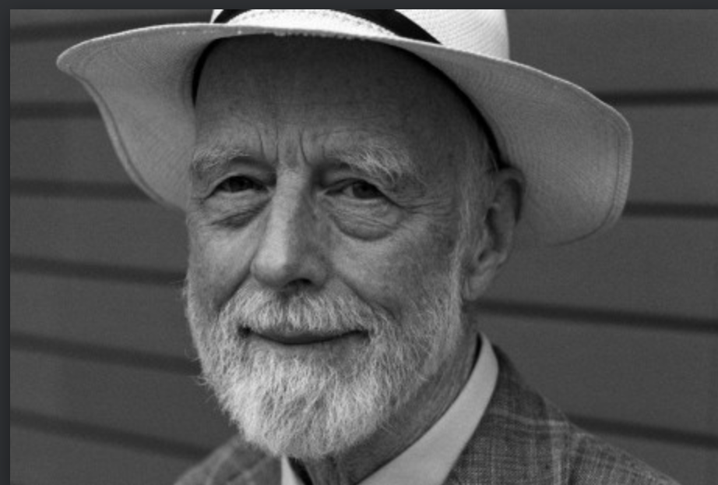

holistic specs - invariants

Slide 20
holistic specs - invariants
++
state
time
space
control
permission
authority
(when/where do they hold)

Slide 21
holistic spec - reduce balance
∀ e:ERC20. ∀ c1: Client. ∀ m: Nat. [ e.balance(c1) = Was(e.balance(c1)) - m
( ∃c2,c3: Client. Was ( c1.Calls(e,transfer,c2,m) ) )
➝
effect
∨ Was ( e.Authorized(c1,c2,m) ∧ c2.Calls(e,transferFrom,c1,c3,m) ) ) ]
necessary condition
This says: A client’s balance decreases only if that client, or somebody authorised by that client, made a payment.

Slide 22
holistic spec - authority
effect
e.Authorized(c1,c2,m) ⩧
Was( c1.Calls(e,approve,c2,m) )
∨
Was( e.Authorized(c1,c2,m+m’) ∧ c2.Calls(e,transferFrom,c1,_,m’) )
∨
Was( e.Authorized(c1,c2,m) ∧ ¬ c2.Calls(e,transferFrom,c1,_,_) )
necessary conditions
c2 is authorised by c1 for m iff
in previous step c1 informed e that it authorised c2 for m
or in previous step c2 was authorised for m+m’ and spent m’ for c1
or in previous step c2 was authorised for m and did not spend c1

Slide 23
Example 3: DOM attenuation
Access to any Node gives access to complete tree
:Node p:..
Wrappers have a height; Access to Wrapper w allows modification of Nodes under the w.height-th parent
and nothing else
:Node p:..
:Node p:..
unknwn1
:Node p:..
:Node p:..
:Node p:..
unknwn2
w:Wrapper height=1
:Node p:..
:Node p:..
:Node p:..

Slide 24
DOM attenuation
function mm(unknwn){ n1:=Node(…); n2:=Node(n1,…);n3:=Node(n2,…);n4:=Node(n3,…); n2.p:=“robust”; n3.p:=“volatile”;
open world
w=Wrapper(n4,1);
n1:Node p:..
unknwn.untrusted(w);
….
Here: n3.p = ????
n2.p = “robust”
Here: n3.p = ????
n2.p = ????
n2:Node p:..
:Node p:..
n3:Node p:..
How do we specify Wrapper?
n4:Node p:..
:Node p:..
unknwn
w:Wrapper height=1
:Node p:..
:Node p:..
:Node p:..

Slide 25
classical
Access to Wrapper w allows modification of Nodes under the w.height-th parent and nothing else
???? 😕 😕 😕 ????
:Node p:..
:Node p:..
:Node p:..
unknwn1
:Node p:..
:Node p:..
:Node p:..
unknwn2
w:Wrapper height=1
:Node p:..
:Node p:..
:Node p:..

Slide 26
holistic
If
a node nd is “outside” set S
then
any execution involving no more than S does not modify nd.p
Outside(nd,S) iff ….
:Node p:..
:Node p:..
:Node p:..
unknwn1
:Node p:..
:Node p:..
:Node p:..
unknwn2
w:Wrapper height=1
:Node p:..
:Node p:..
:Node p:..

Slide 27
holistic
∀S:Set. ∀nd:Node.
[ Outside(nd,S) → ¬ ( Will(Changes(nd.p)) in S ) ]
nd outside S
Execution involves no more than S
:Node p:..
Outside(nd,S) iff ...
Does not modify nd.p
:Node p:..
:Node p:..
unknwn1
:Node p:..
:Node p:..
:Node p:..
unknwn2
w:Wrapper height=1
:Node p:..
:Node p:..
:Node p:..

Slide 28
holistic
∀S:Set. ∀nd:Node.
[ Outside(nd,S) → ¬ ( Will(Changes(nd.p)) in S ) ]
Outside(nd,S) iff ∀o∈S. ∀path [ o.path = nd →
[ o:Node ∨
∃ path’,fs. ( path=path’.fs ∧ o.path’:Wrapper ∧ Distance(o.path’,nd)>o.path’.height ) ] ]
Distance(nd,nd’) = min{ k | nd.parent^{k} = nd’.parent^{j} ]
:Node p:..
:Node p:..
:Node p:..
unknwn1
:Node p:..
:Node p:..
:Node p:..
unknwn2
w:Wrapper height=1
:Node p:..
:Node p:..
:Node p:..

Slide 29
Outside(RedNode,YellowSet)
Outside(nd,S) iff ∀o∈S. ∀path [ o.path = nd →
[ o:Node ∨
∃ path’,fs. ( path=path’.fs ∧ o.path’:Wrapper ∧ Distance(o.path’,nd)>o.path’.height ) ] ]
Distance(nd,nd’) = min{ k | nd.parent^{k} = nd’.parent^{j} ]
:Node p:..
:Node p:..
:Node p:..
unknwn1
:Node p:..
ç
:Node p:..
:Node p:..
unknwn2
w:Wrapper height=1
:Node p:..
:Node p:..
:Node p:..

Slide 30

using holistic spec
function mm(unknwn){ n1:=Node(…); n2:=Node(n1,…);n3:=Node(n2,…);n4:=Node(n3,…); n2.p:=“robust”; n3.p:=“volatile”;
w=Wrapper(n4,1);
n1:Node p:..
unknwn.untrusted(w);
….
With holistic spec we can show that despite the call to unknown object, at this point: n2.p = “robust”
n2:Node p:..
:Node p:..
n3:Node p:..
n4:Node p:..
:Node p:..
unknwn
w:Wrapper height=1
:Node p:..
:Node p:..
:Node p:..

Slide 31

Bank and Account
Banks and Accounts
Accounts hold money
Money can be transferred between Accounts
A banks’ currency = sum of balances of accounts held by bank
[Miller et al, Financial Crypto 2000]

Slide 32
Bank/Account - 2
classical
robustness
Pol_1: With two accounts of same bank one can transfer money between them.
Pol_2: Only someone with the Bank of a given currency can violate conservation of that currency
Pol_3: The bank can only inflate its own currency
Pol_4: No one can affect the balance of an account they do not have.
Pol_5: Balances are always non-negative.
Pol_6: A reported successful deposit can be trusted as much as one trusts the account one is depositing to.
[Miller et al, Financial Crypto 2000]

Slide 33
Pol_4 — classical
Pol_4: No-one can affect the balance of an account they do not have
???? 😕 😕 😕 ????

Slide 34
Pol_4 — holistic
Pol_4: No-one can affect the balance of an account they do not have
a:Account ∧ Will ( Changes(a.balance) ) in S ) →
necessary condition
∃o∈S. [External(o) ∧ Access(o,a) ]
This says: If some execution starts now and involves at most the objects from S, and modifies a.balance at some future time, then at least one of the objects in S is external to the module, and can access a directly now.

Slide 35
Today
Traditional Specifications do not adequately address Robustness
Holistic Specifications — Summary and by Example
Holistic Specification Semantics

Slide 36
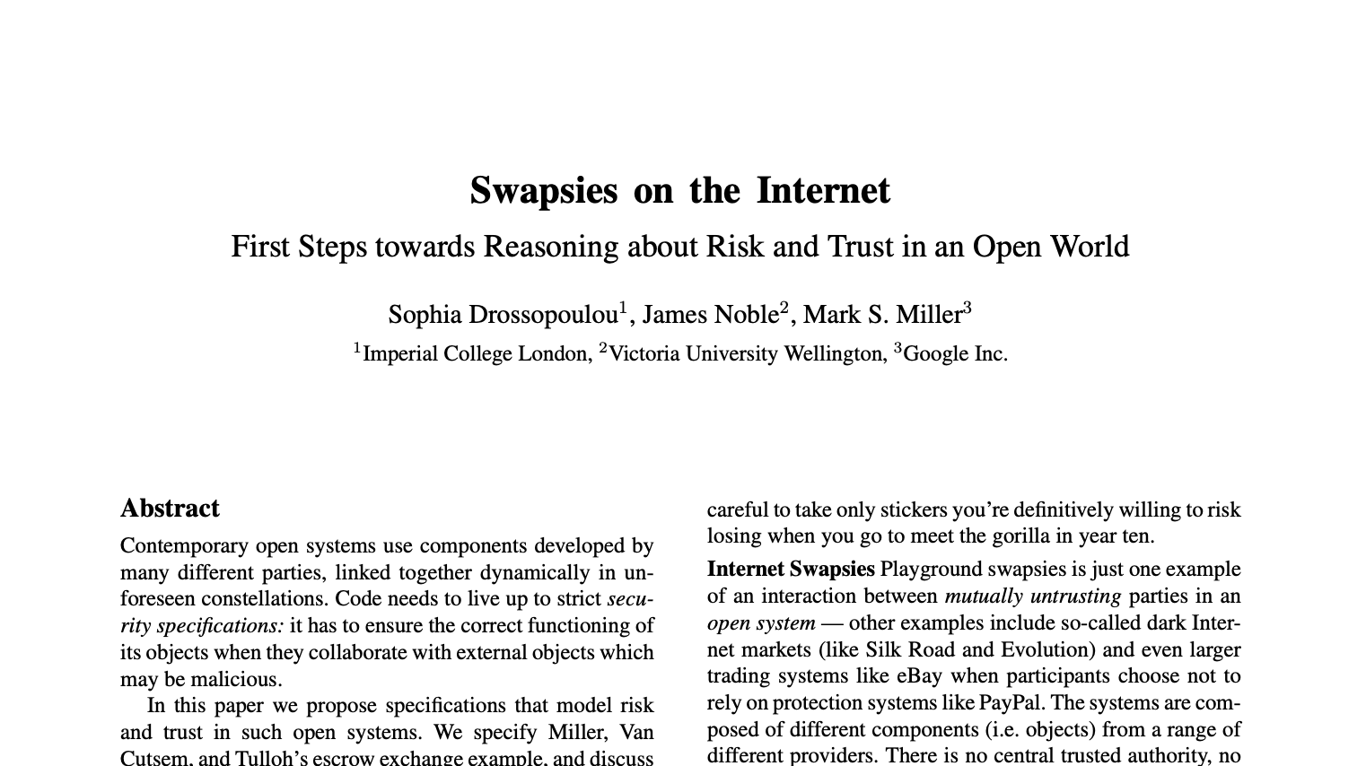
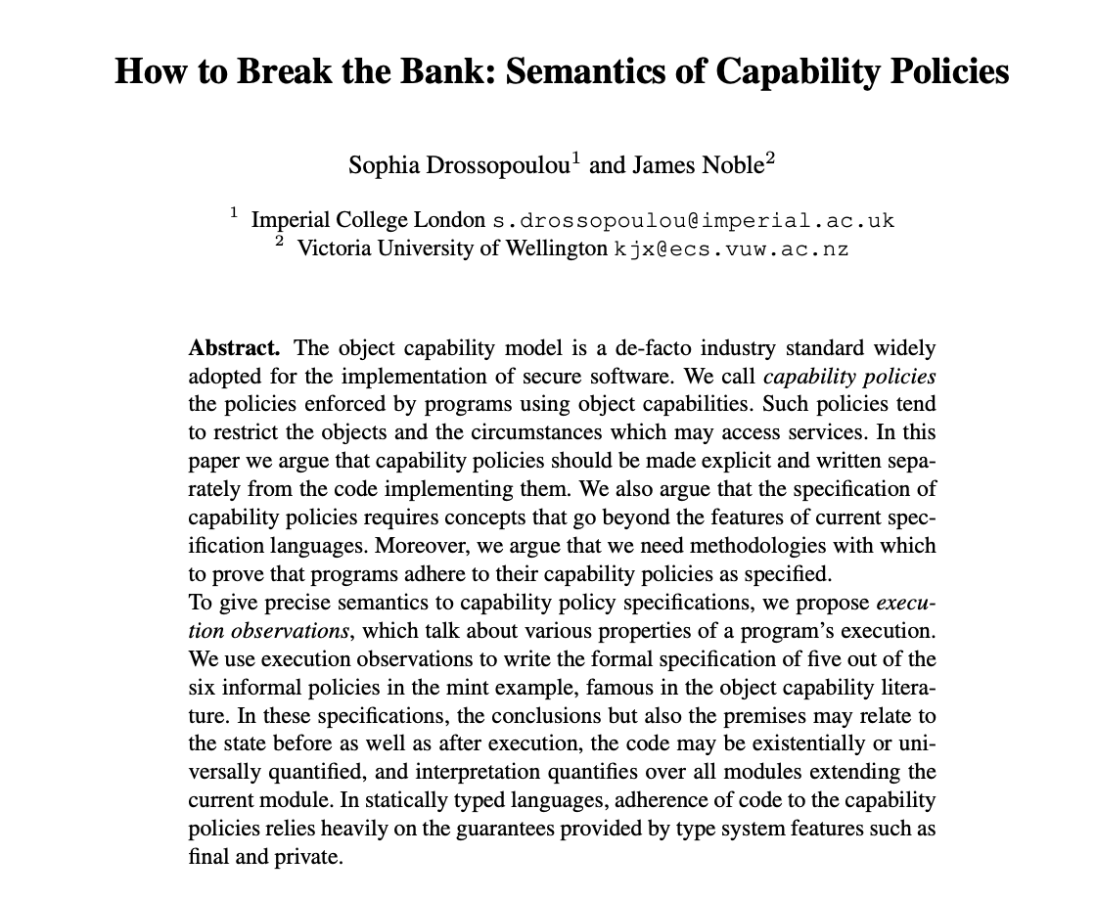
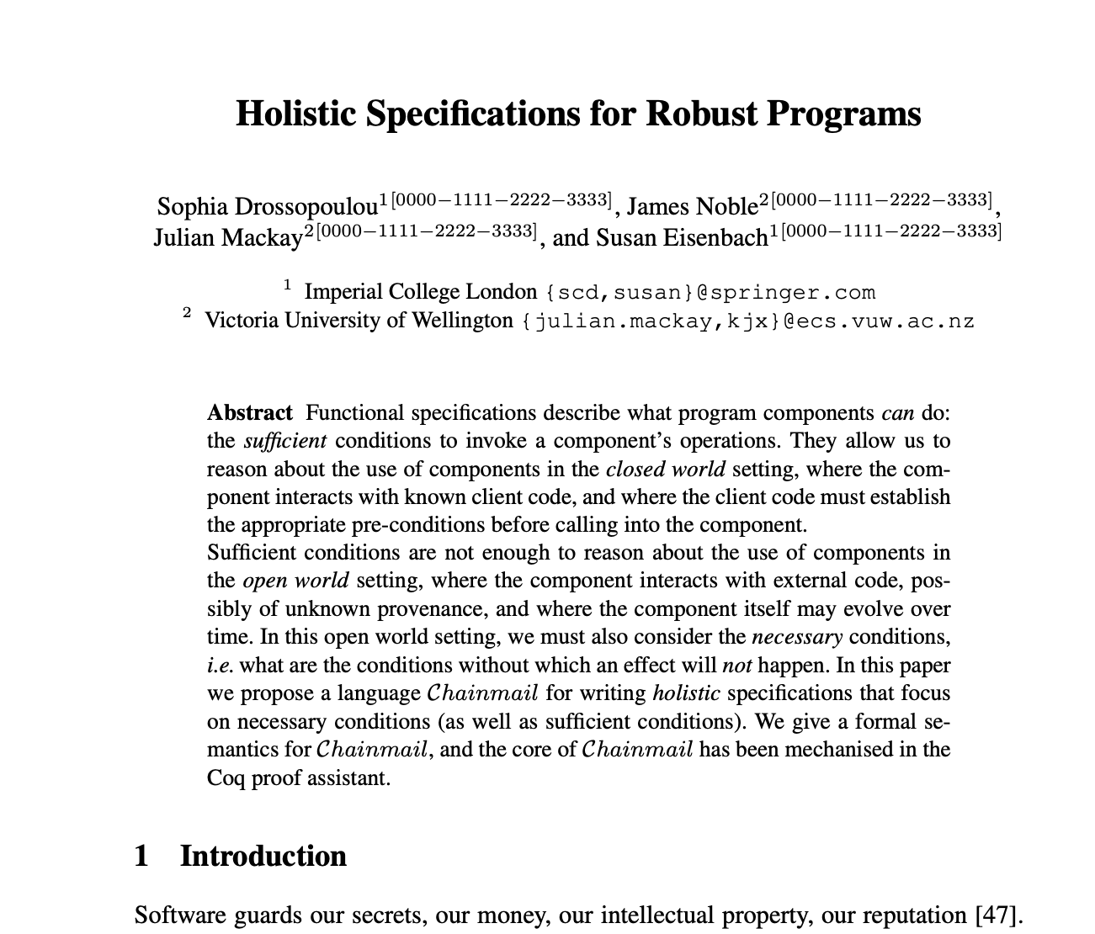
Chainmail

Slide 37
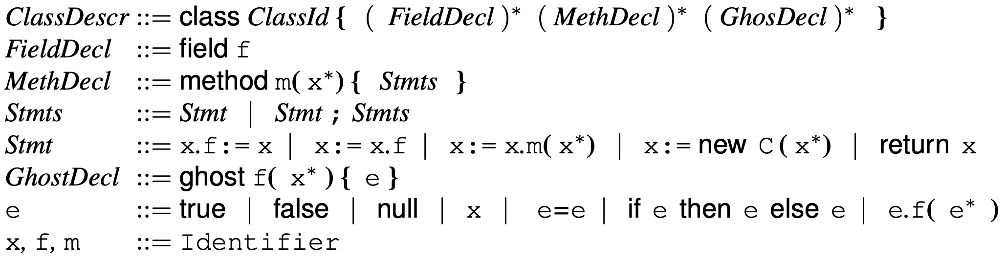
Loo syntax

Slide 38
Giving meaning to holistic Assertions
We define in a“conventional” way (omit from slides): module M : Ident —-> ClassDef ∪ PredicateDef ∪ FunctionDef configuration σ : Heap × Stack × Code execution M, σ ↝ σ’
Define module concatenation * so that
M*M’ undefined, iff dom(M)∩dom(M’) ≠∅ otherwise (M*M’)(id) = M(id) if M’(id) undefined, else M’(id)
We will define
M, σ ⊨ A Initial(σ) and Arising(M) M ⊨ A
Lemma
M*M’ = M’*M
(M1*M2)*M3 = M1*(M2*M3)
M, σ ↝ σ’ ∧ M*M’ defined ⟶ M*M’, σ ↝ σ’

Slide 39
Giving meaning to holistic Assertions
We define in a“conventional” way (omit from slides): module M : Ident —-> ClassDef ∪ PredicateDef ∪ FunctionDef configuration σ : Heap × Stack × Code execution M, σ ↝ σ’
Define module concatenation * so that
M*M’ undefined, iff dom(M)∩dom(M’) ≠∅ otherwise (M*M’)(id) = M(id) if M’(id) undefined, else M’(id)
We will define M, σ ⊨ A Initial(σ) and Arising(M) M ⊨ A

Slide 40
Holistic Assertions — summary
e ::= this | x | e.fld | …
A ::= e>e | e=e | …
| A → A | A ∧ A | ∃x. A | …
| Access(e,e’)
permission
| Changes(e)
authority
| Will(A) | Was(A)
time
space
| A in S | External(e)
| x.Call(y,m,z1,..zn)
control
| x obeys A
trust

Slide 41
Semantics of Expressions
e ::= this | x | e.fld | func(e1,…en) | …
Define ⎣e⎦M,σ as expected
:Node p:888
unknwn1
:Node p:..6
par
nd
:Node p:.4
par
Eg, ⎣unknwn1.nd.par.par.p⎦M,σ =888

Slide 42
Semantics of holistic Assertions
“Conventional part” A ::= e>e | A → A | ∃x.A | …
We define M, σ ⊨ A
M,σ ⊨ e>e’ iff ⎣e⎦M,σ > ⎣e’⎦M,σ
M,σ ⊨ A→A’ iff M,σ ⊨ A implies M,σ ⊨ A’ M,σ ⊨ ∃x.A iff M,σ[z↦ι ] ⊨ A[x↦z ] for some ι∈dom(σ.heap), and z free in A

Slide 43
Giving a meaning to Assertions
“Conventional part” A ::= e>e | A → A | P(e1,..en) | ∃x.A | …
We define M, σ ⊨ A
M,σ ⊨ e>e’ iff At M,σ value of e is larger than value e’
M,σ ⊨ A→A’ iff If A valid at M,σ ⊨ A implies M,σ ⊨ A’ M,σ ⊨ P(e1,…en) iff M,σ ⊨ M(P)[x1↦⎣e1⎦M,σ,.…xn↦⎣en⎦M,σ] M,σ ⊨ ∃x.A iff M,σ[z↦ι ] ⊨ A[x↦z ] for some ι∈dom(σ.heap), and z free in A

Slide 44
Semantics of holistic Assertions
“Unconventional part”
A ::= Access(x,x') | Changes(e) | Will(A) | A in S | x.Calls(y,m,z1,..zn)
M,σ ⊨ Access(x,x') iff ⎣x⎦M,σ = ⎣x'⎦M,σ ∨ ⎣x.fld⎦M,σ = ⎣x'⎦M,σ for some field fld ∨ ⎣this⎦M,σ = ⎣x⎦M,σ ∧⎣y⎦M,σ =⎣x'⎦M,σ ∧ y is formal parameter of current function
M,σ ⊨ Changes(e) iff M, σ ↝ σ’ ∧ ⎣e⎦M,σ ≠⎣e⎦M,σ’
M,σ ⊨ Will(A) iff ∃σ’.[ M,σ ↝*σ’ ∧ M, σ’ ⊨ A ]
M,σ ⊨ A in S iff M,σ@Os ⊨ A where Os = ⎣S⎦M,σ
M,σ ⊨ x.Calls(y,m,z1,..zn) iff ⎣this⎦M,σ = ⎣x⎦M,σ ∧ σ.code=y’.m(z1’..zn’) ∧ …

Slide 45
Semantics of holistic Assertions - the full truth -
M,σ ⊨ Access(e,e') iff … as before …
M,σ ⊨ Changes(e) iff M, σ ↝ σ’ ∧ ⎣e⎦M,σ ≠⎣e[z↦y]⎦M,σ’[y↦σ(z)] where {z}=Free(e) ∧ y fresh in e, σ,σ’
M,σ ⊨ Will(A) iff ∃σ’,σ’’,φ.[ σ = σ’.φ ∧ M,φ ↝*σ’ ∧
M, σ’[y↦σ(z)] ⊨ A[z↦y] ] where {z}=Free(A) ∧ y fresh in A, σ,σ’
M,σ ⊨ A In S iff M,σ@Os ⊨ A where Os = ⎣S⎦M,σ
M,σ ⊨ x.Calls(y,m,z1,..zn) iff … as before …

Slide 46

Giving meaning to Assertions
outstanding definitions
M,σ ⊨ Access(x,y) iff ….
M,σ ⊨ Changes(e) iff ….
M,σ ⊨ Will(A) iff …
M,σ ⊨ A in S iff M,σ@OS ⊨ A where OS = ⎣S⎦M,σ
M,σ ⊨ x.Calls(y.m(x1,..xn)) iff …

Slide 47
Arising Configurations
A runtime configuration is initial iff 1) The heap contains only one object, of class Object
2) The stack consists of just one frame, where this points to that object.
The code can be arbitrary
Initial(σ) iff σ.heap=(1↦(Object,…) ) ∧ σ.stack=(this↦1).[ ]
A runtime configuration σ arises from a module M if there is some initial configuration σ0 whose execution M in reaches σ in a finite number of steps.
Arising(M) = { σ | ∃ σ0. Initial(σ0) ∧ M, σ0 ↝* σ }

Slide 48
Arising expresses “defensiveness”
Assume a Tree-module, Mtree.
blue configuration arises from Mtree*M’ for some module M’
brown configuration does not arise from Mtree*M’ for any module M’
:Node p:888
:Node p:888
:Node p:..6
par
par
:Node p:..6
par
:Node p:.4
par
par
par
:Node p:.4

Slide 49
Giving meaning to Assertions
M ⊨ A iff ∀M’.∀σ∈Arising(M*M’). M*M’, σ ⊨ A
A module M satisfies an assertion A if all runtime configurations σ which arise from execution of code from M*M’ (for any module M’), satisfy A.
open world

Slide 50
Entailments
Definitions
M ⊨ A ⊆ A’ iff ∀σ∈Arising(M). [ M, σ ⊨ A → M, σ ⊨ A’ ]
M ⊨ A ⊑ A’ iff M ⊨ A → M ⊨ A’
Facts
M ⊨ A ⊆ A’ implies M ⊨ A ⊑ A’
M ⊨ A ⊑ A’ does not imply M ⊨ A ⊆ A’
M ⊨ ( Will(A) → A’ ) ⊑ ( A’ → Was(A) )
M ⊨ A @ S and M ⊨ S ⊆ S’ does not imply M ⊨ A @ S’
We call A monotonic, if M,σ ⊨ A @ S and M,σ ⊨ S ⊆ S’ imply M,σ ⊨ A @ S’
If A monotonic, then M,σ ⊨ (•A)@S and M,σ ⊨ S’=Allocated imply M,σ ⊨ • (A @ (S∪(Allocated\S’)) )
M ⊨ A @ S and M ⊨ S ⊆ S’ imply M ⊨ A @ S’?
M,σ ⊨ (•A)@S imply M ⊨ •(A@S)?

Slide 51
Summary of our Proposal
A ::= e>e | e=e | f(e1,..en) | …
| A → A | A ∧ A | ∃x. A | …
permission
| Access(x,y)
| Changes(e)
authority
| Will(A) | Was(A)
time
space
| A in S
| x.Calls(y,m,z1,..zn)
call
Arising(M)
M, σ ⊨ A
M ⊨ A

Slide 52
Classical Specification
vs
Holistic Specification
fine-grained
per function
ADT as a whole
emergent behaviour
Which is “stronger”? “Closed” ADT with classical spec implies holistic spec. (closed: no functions can be added, all functions have classical specs, ghost state has known representation)
Why do we need holistic specs? * “closed ADT” is sometimes too strong a requirement. * Holistic aspect is cross-cutting (eg no payment without authorization) * Allows reasoning in open world (eg DOM wrappers)

Slide 53
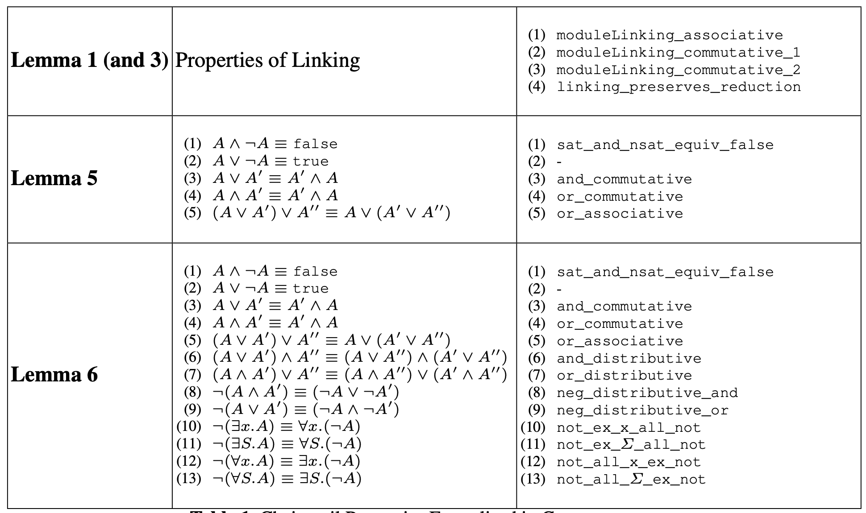

Slide 54
Challenges
adaptations for time, Was<…>
dealing with space <.. in ..>
ghostfields, (treat cycles)
keeping assertions classical
Language properties, eg only connectivity begets connectivity
Coq model and proofs of language properties
Coq proof of some of the holistic specs
Still to do ..
Proof logic. Can we avoid explicit naming of configurations
Trust and Risk
trust
A ::= … | e obeys Spec

Slide 55

Thank you

